Slide 1
Proctor Diary Management System
PROJECT WORK – 2
Done By :
Vivek Rajeev (1BM18CS142)
Sai Sriram Vemparala (1BM18CS140)
Sarvesh A(1BM18CS144) & Gowri (1BM18CS133)

Slide 2
Abstract
Proctorial system mainly provides an interface for communication between the proctor and their proctees. This project includes sending the progress reports of each student to his/her proctor furnishing the details of class marks, and examination results.
This system has special access to the proctor to update the student’s details and also includes validating the student’s marks. The administrator has the complete access to database so that the users do not modify the details updated by proctor.

Slide 3
Introduction
Most of the colleges follow physical attendance entry (paper based) now a days. But in this system, we are not supposed to maintain pen, paper based participation. Using this idea, we have proposed a participation checking framework built in the idea of web administrations which is executed as an web based application that interconnects with the database that resides on a remote server. The application will associate with the database using a server. Our developed project is efficient and user friendly and very easy to use Android application for taking attendance. This application will be introduced on the client’s browser

Slide 4
Aim
To create a web based system to automate the manual system used for management and maintenance of the critical information which reduces a lot of paper work. This system provides parents an easy access to their ward’s academic performance.

Slide 5
Objectives:
Proctorial student information system provides a simple interface for the maintenance of student information. It can be used by educational Institutes or colleges to maintain the records of students easily.
This system focuses on presenting information in an easy and intelligible manner which provides facilities like online registration and profile creation of student’s thus reducing paper work and automating the record generation process in an educational institution.

Slide 6
Hardware & Software Requirements
Any Linux / Windows host or shared hosting service with PHP/MySQL and PHP (mysqli extension enabled).
The one we recommend using is XAMPP.

Slide 7
Schema

Slide 8
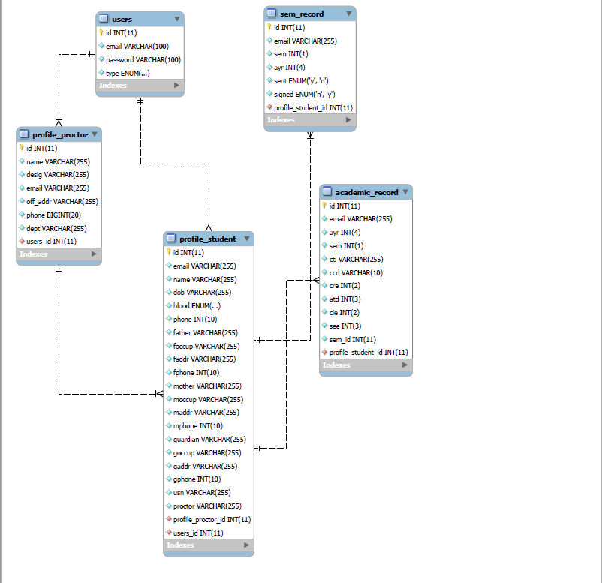

Slide 9
Entity Relationship Diagram

Slide 10
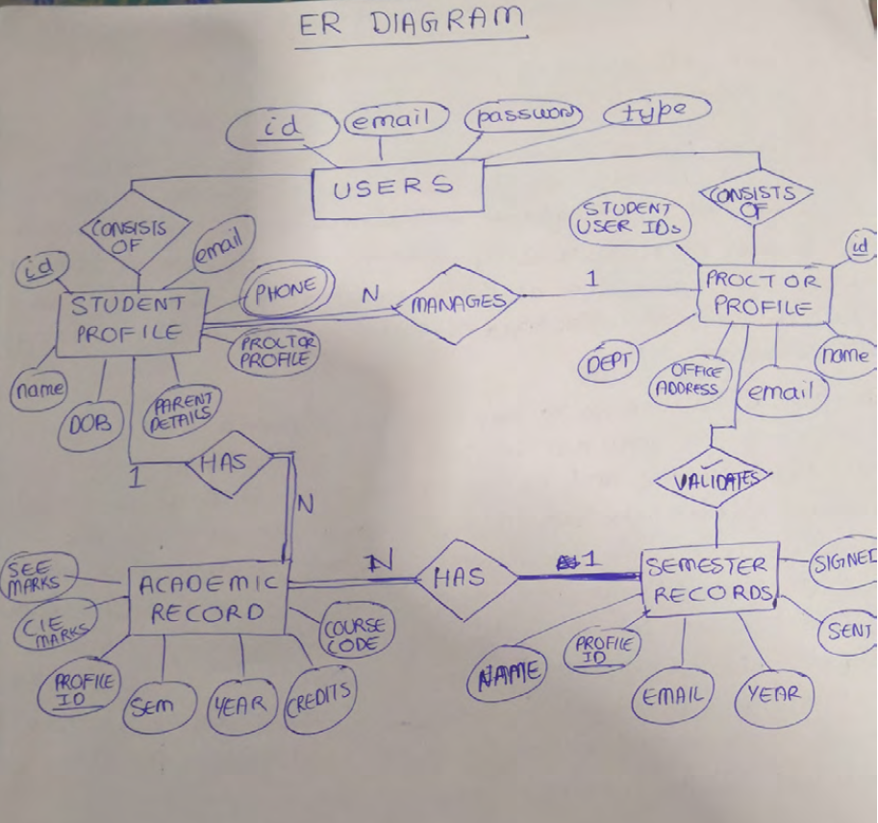

Slide 11
Architecture
Easy to use: The proposed framework is easy to use on the grounds that the access and storage of information will be quick and records will be kept professionally sheltered. Besides the GUI is given in the proposed framework, which conveys client to manage the framework effortlessly. Reports are effortlessly produced: Reports can be just produced in the proposed framework, so administrator can deliver the report according to the prerequisite (month to month) or in the mid of the session. Administration can give the notice to the worker so clients get to be consistent.
Very less paper work: The proposed application obliges low paper work. All the information is nourished into the framework promptly and reports can be produced through PCs. Moreover exertion gets to be simple on the grounds that there is no need to keep the information as papers.

Slide 12
Implementation
Proctor Module :
Staff can register with name, username, password and mobile number. Also the staff can validate the student’s marks. Staff can also message and view student details.
Student Module :
Students can edit their profile and upload their marks . After the student logs in with valid username and password, he can perform the above mentioned actions an also message the proctor.

Slide 13
Result & Conclusion :
An web based application is created. The application offers user friendly activity, less time consumption. It can also be used for uploading and validating marks inside the college premises via the website, time will be saved, and a lot of paperwork will be reduced by using this application.

Slide 14
Future Enhancement :
According to college level the staff will get benefits by using this application. As the staff can login by using the application in college, they can take attendance, validate marks, personally message individual student and convey important news. The information of the students will be submitted to database. Manual work gets reduced. Online fees payment, online admission, online assignments, online tests and online classroom can also be implemented in this project.

